Slide 1
Mathematical Economics
Lecture 9

Slide 2

Plan
Isomorphism between $X (dimX=n)$ and $ℝ^{n}$
Isomorphism between $L\left(X, Y\right) (dimX=n,dimY=m)$ and $M_{m×n}$
Change of Basis and Similarity

Slide 3


Isomorphism between $X$ and $ℝ^{n}$
$V=\{v_{1},…,v_{n}\}∈X$ is a basis of $X$
$↪ ∀x∈X$ has a unique representation $x=\sum_{i=1}^{n}{α_{i}v_{i}}$
${crd}_{V}\left(x\right)=\left(\begin{matrix}α_{1} \\ ⋮ \\ α_{n}\end{matrix}\right)∈ℝ^{n}$
Isomorphism from $X$ to $ℝ^{n}$

Slide 4
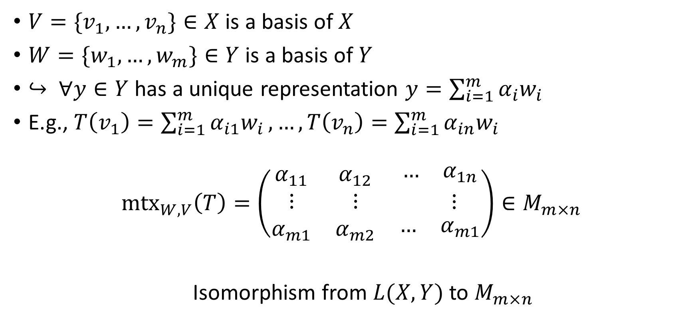
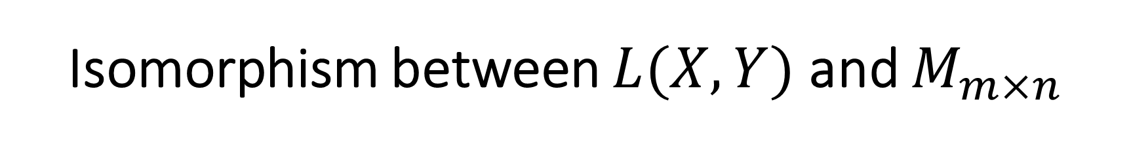
Isomorphism between $L(X,Y)$ and $M_{m×n}$
$V=\{v_{1},…,v_{n}\}∈X$ is a basis of $X$
$W=\{w_{1},…,w_{m}\}∈Y$ is a basis of $Y$
$↪ ∀y∈Y$ has a unique representation $y=\sum_{i=1}^{m}{α_{i}w_{i}}$
E.g., $T\left(v_{1}\right)=\sum_{i=1}^{m}{α_{i1}w_{i}},…,T\left(v_{n}\right)=\sum_{i=1}^{m}{α_{in}w_{i}}$
$${mtx}_{W,V}\left(T\right)=\left(\begin{matrix}α_{11} & α_{12} & \begin{matrix}… & α_{1n}\end{matrix} \\ ⋮ & ⋮ & \begin{matrix} & ⋮\end{matrix} \\ α_{m1} & α_{m2} & \begin{matrix}… & α_{m1}\end{matrix}\end{matrix}\right)∈M_{m×n}$$
Isomorphism from $L(X,Y)$ to $M_{m×n}$

Slide 5
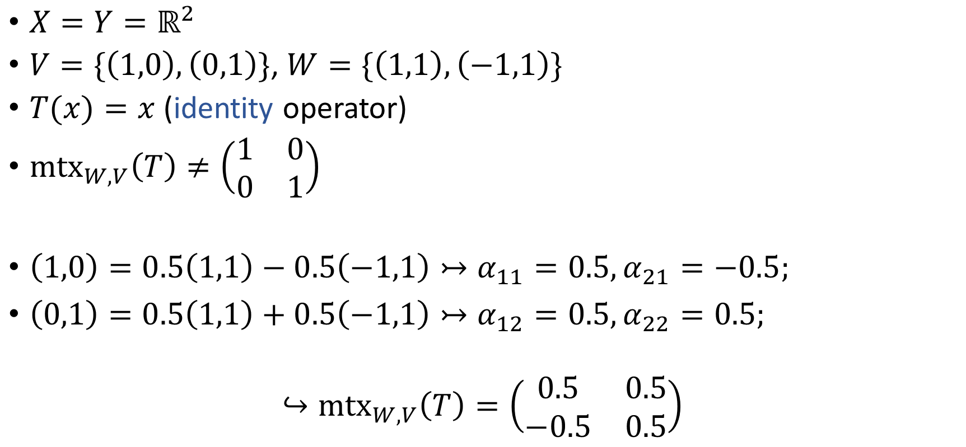
Example
$X=Y=ℝ^{2}$
$V=\{\left(1,0\right),\left(0,1\right)\}$, $W=\{\left(1,1\right),\left(−1,1\right)\}$
$T(x)=x$ (identity operator)
${mtx}_{W,V}\left(T\right)≠\left(\begin{matrix}1 & 0 \\ 0 & 1\end{matrix}\right)$
$\left(1,0\right)=0.5\left(1,1\right)−0.5\left(−1,1\right)↣α_{11}=0.5,α_{21}=−0.5;$
$\left(0,1\right)=0.5\left(1,1\right)+0.5\left(−1,1\right)↣α_{12}=0.5,α_{22}=0.5;$
$$↪{mtx}_{W,V}\left(T\right)=\left(\begin{matrix}0.5 & 0.5 \\ −0.5 & 0.5\end{matrix}\right)$$

Slide 6
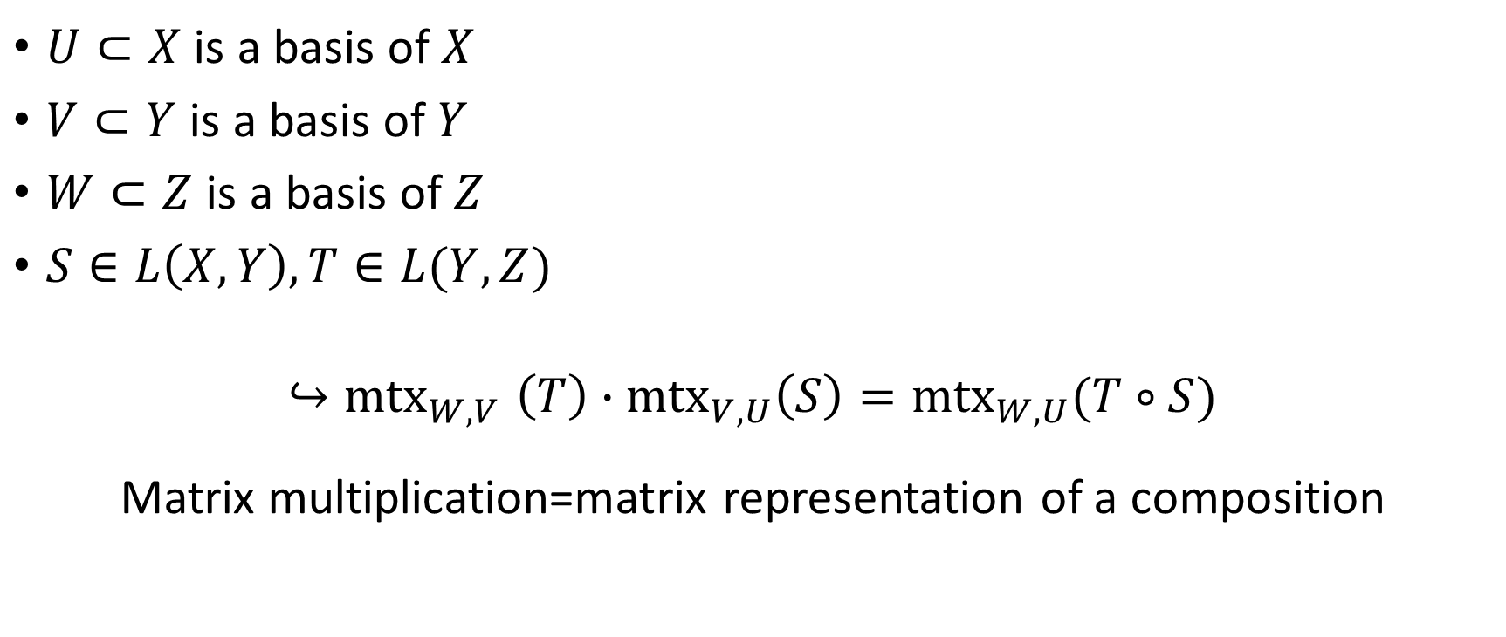
Matrix Representation of a Composition of Linear Functions
$U⊂X$ is a basis of $X$
$V⊂Y$ is a basis of $Y$
$W⊂Z$ is a basis of $Z$
$S∈L\left(X,Y\right), T∈L(Y,Z)$
$${↪mtx}_{W,V}\left(T\right)∙{mtx}_{V,U}\left(S\right)={mtx}_{W,U}(T∘S)$$
Matrix multiplication=matrix representation of a composition

Slide 7

Change of Basis
$dimX=n,T∈L\left(X, X\right)$
${mtx}_{V}\left(T\right)≡{mtx}_{V,V}\left(T\right)$
How does ${mtx}_{V}\left(T\right)$ change if we change basis from $V$ to $W$?

Slide 8
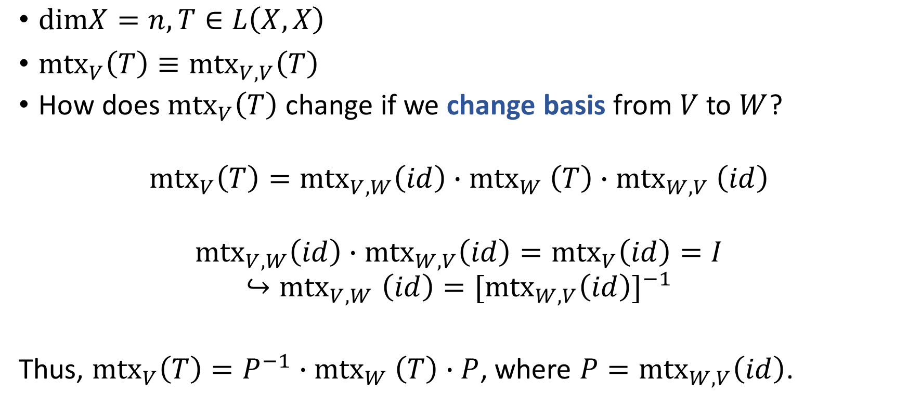
Change of Basis
$dimX=n,T∈L\left(X, X\right)$
${mtx}_{V}\left(T\right)≡{mtx}_{V,V}\left(T\right)$
How does ${mtx}_{V}\left(T\right)$ change if we change basis from $V$ to $W$?
$${mtx}_{V}\left(T\right)={mtx}_{V,W}\left(id\right){∙mtx}_{W}\left(T\right){∙mtx}_{W,V}\left(id\right)$$
$${mtx}_{V,W}\left(id\right)∙{mtx}_{W,V}\left(id\right)={mtx}_{V}\left(id\right)=I$$
$${↪mtx}_{V,W}\left(id\right)=[{mtx}_{W,V}\left(id\right)]^{−1}$$
Thus, ${mtx}_{V}\left(T\right)=P^{−1}{∙mtx}_{W}\left(T\right)∙P$, where $P={mtx}_{W,V}\left(id\right)$.

Slide 9
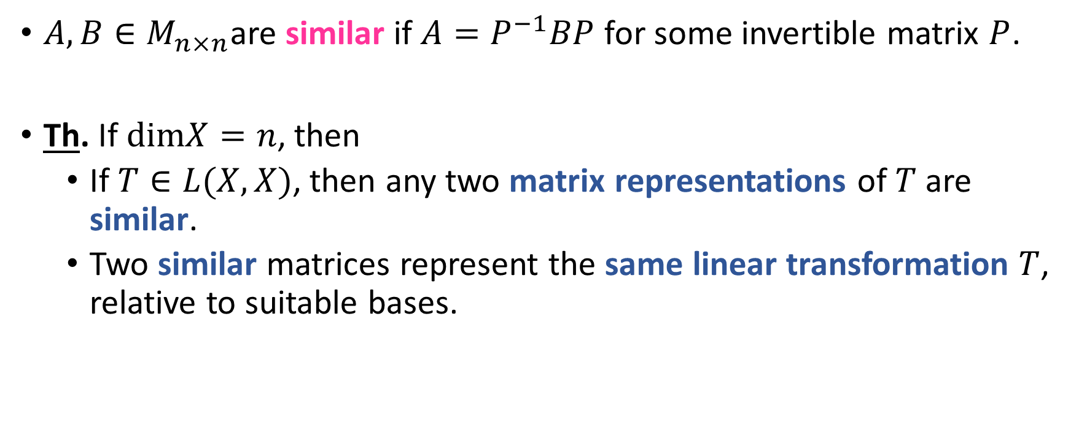
Similarity
$A,B∈M_{n×n}$are similar if $A=P^{−1}BP$ for some invertible matrix $P$.
Th. If $dimX=n$, then
If $T∈L(X,X)$, then any two matrix representations of $T$ are similar.
Two similar matrices represent the same linear transformation $T$, relative to suitable bases.

